Slide 1
THE LENDING CLUB
CASE STUDY
Created By:
Shweta Jain
Chintala Pardha Saradhi

Slide 2
BUSINESS OBJECTIVES
Lending Club is the largest online loan marketplace, facilitating personal loans, business loans, and financing of medical procedures. Borrowers can easily access lower interest rate loans through a fast online interface.
Like most other lending companies, lending loans to ‘risky’ applicants is the largest source of financial loss (called credit loss). The credit loss is the amount of money lost by the lender when the borrower refuses to pay or runs away with the money owed. In other words, borrowers who default cause the largest amount of loss to the lenders. In this case, the customers labelled as 'charged-off' are the 'defaulters'.
The company wants to understand the driving factors (or driver variables) behind loan default, i.e. the variables which are strong indicators of default. The company can utilize this knowledge for its portfolio and risk assessment.

Slide 3
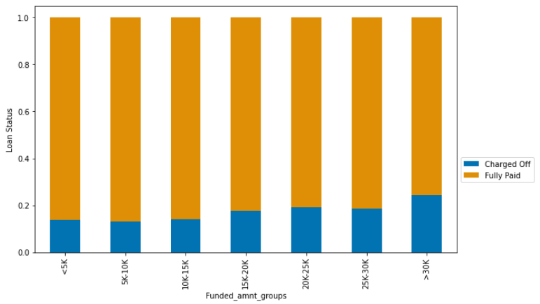
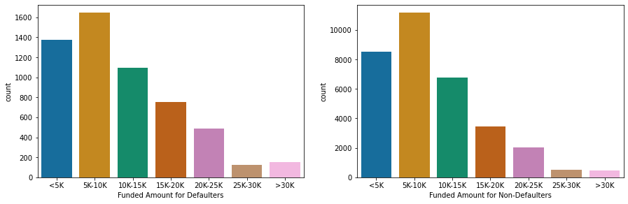
ANALYSING THE FUNDED AMOUNT
In general, most of the loans are taken for an amount between 5K to 10K
Most loan defaulters have a loan for an amount between 5K to 10K
Proportion of loan defaults is highest for >30K funded amount group
Funded Amount for Defaulters and non defaulters

Slide 4
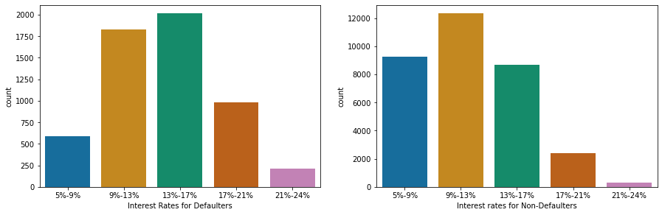
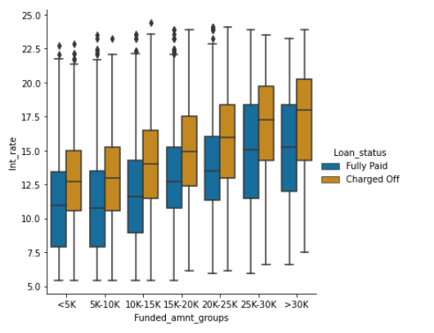
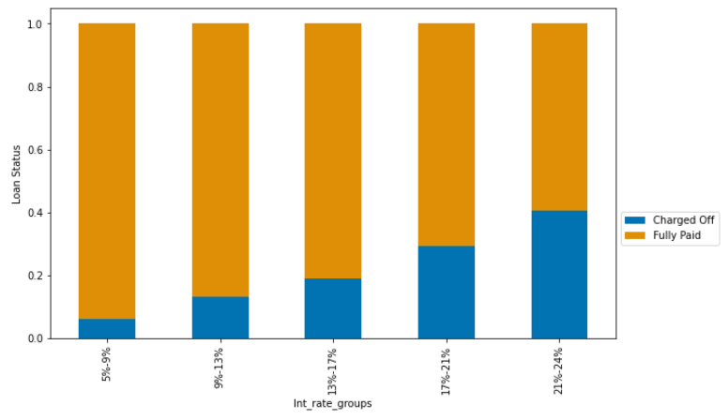
ANALYSING INTEREST RATES
Interest rates are higher for "Charged off" category across all Funded amount groups
Most loan defaulters took a loan at an interest rate between 13%-17%
Most loan non defaulters interest rate is from 9%-13%
Proportion of loan defaults is highest for 21%-24% interest rate group

Slide 5
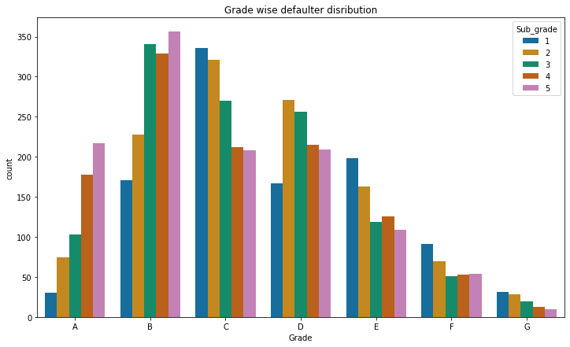
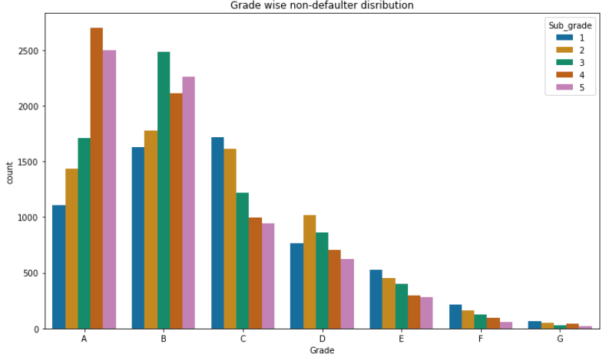
ANALYSING GRADES AND SUB-GRADE
Top five grade/sub-grade in which defaults happen: B5>B3>C1>B4>C2
Safest grade/sub-grade for lending: A4 and A5

Slide 6
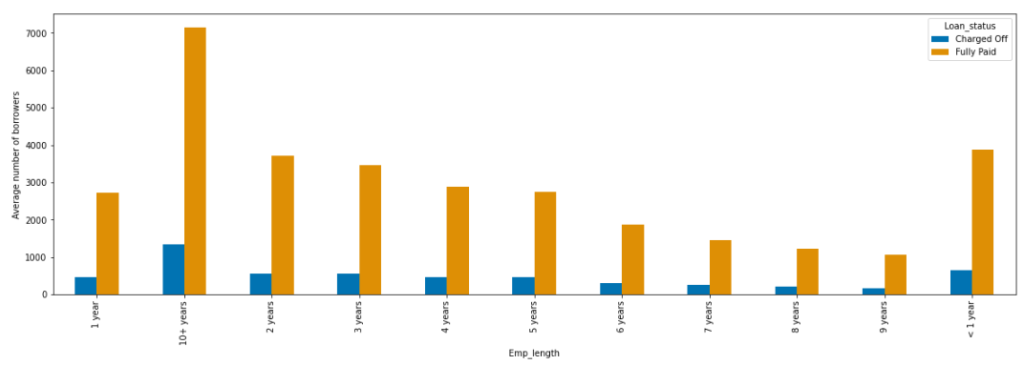
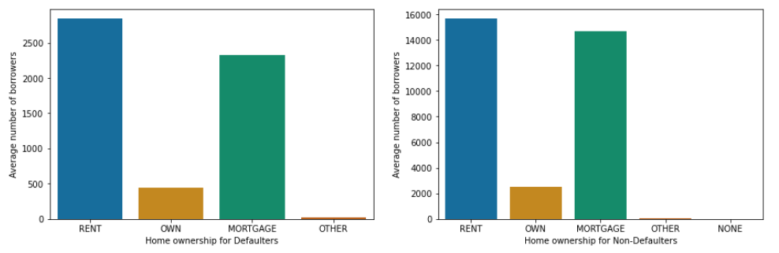
ANALYSING EMPLOYMENT LENGTH
People employed for 10+ years are most likely to default
ANALYSING HOME OWNERSHIP
People living on rent are more likely to default, followed by mortgage

Slide 7
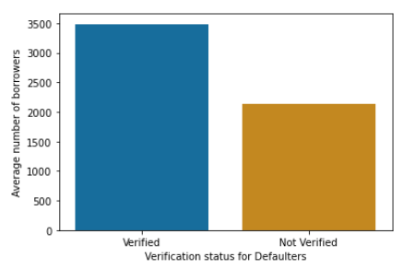
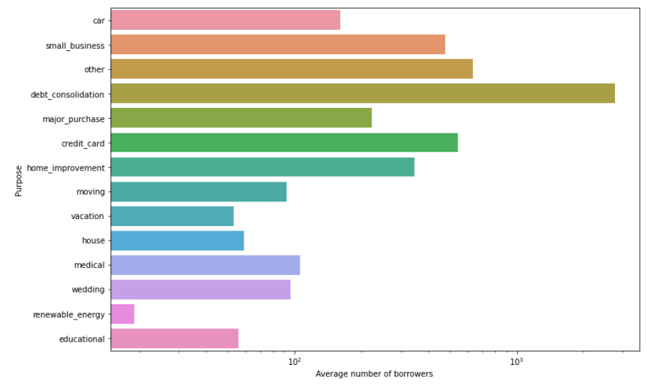
ANALYSING VERIFICATION STATUS
ANALYSING PURPOSE
Quite interestingly, most people who defaulted on loan had their income/ source of income verified at the time of loan grant.
Most people who defaulted took the loan for the purpose of Debt consolidation.

Slide 8
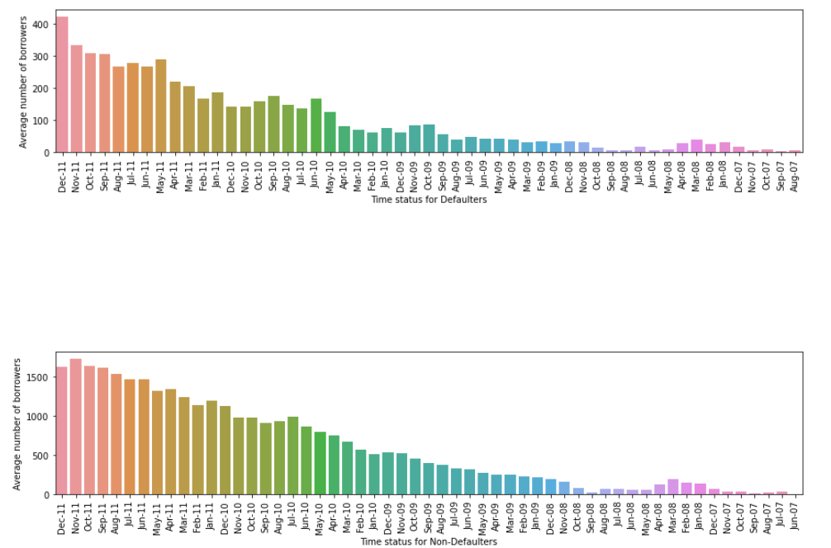
ANALYSING LOAN ISSUE MONTH-YEAR
Maximum loans have been taken in the December 2011
Most loan defaults have also taken place in December 2011

Slide 9
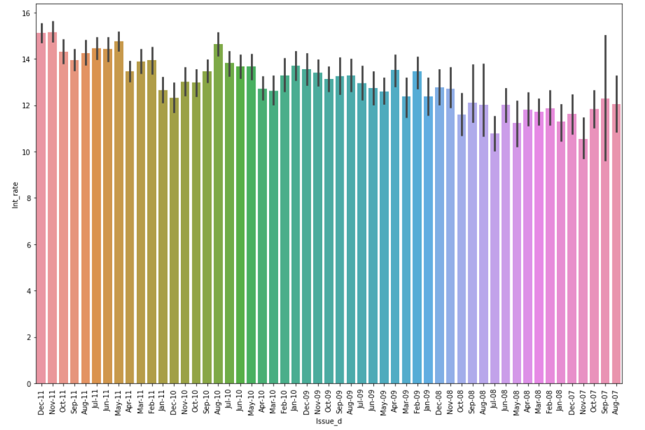
ANALYSING LOAN ISSUE MONTH-YEAR WITH INTEREST RATES
Average Interest rates were the highest for the months of Nov 2011 followed by Dec 2011
This seems to be a case for causation wherein higher interest rates increased the possibility of default. May be the base interest rate was kept higher depending on the market conditions for the months of Nov & Dec 2011, that caused the net interest rate to increase and in turn, the number of defaults also increased

Slide 10
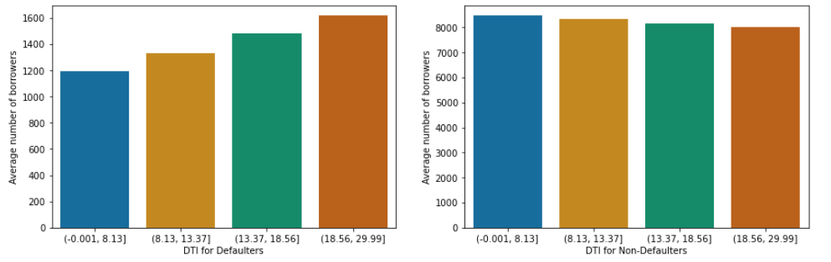
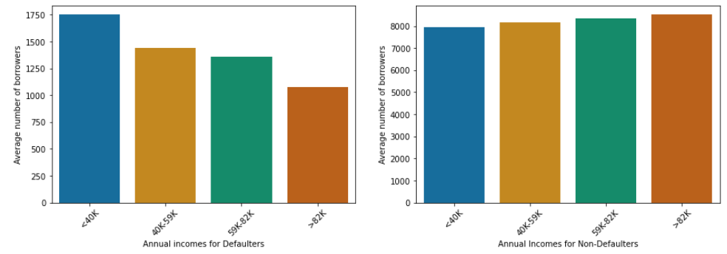
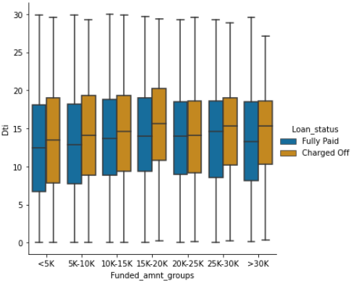
ANALYSING DEBT TO INCOME(DTI) RATIO
Most people who defaulted have a DTI lying in the fourth quartile i.e. 18% to 30% of the monthly income of these people go into their total monthly debt payments
ANALYSING DEBT TO ANNUAL INCOME
People falling in the first quartile of annual income (<40K) are most likely to default
Dti is higher for Charged Off category across all Funded amount groups

Slide 11
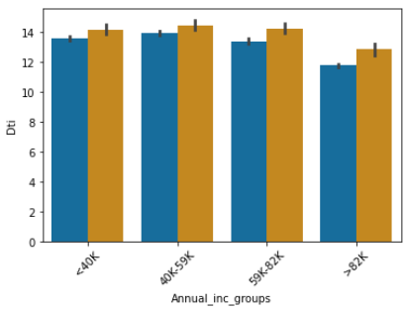
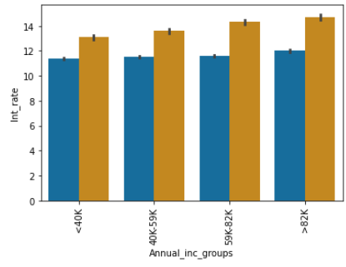
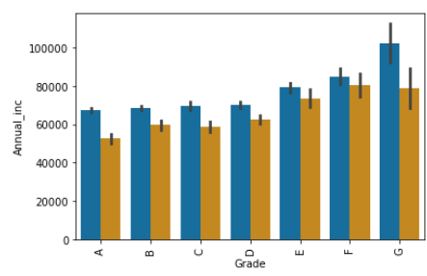
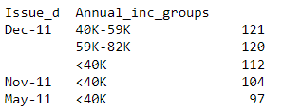
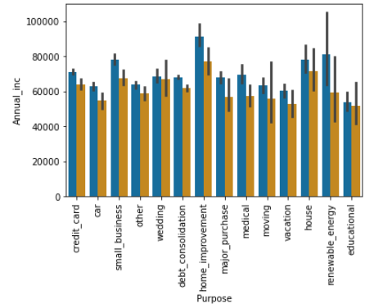
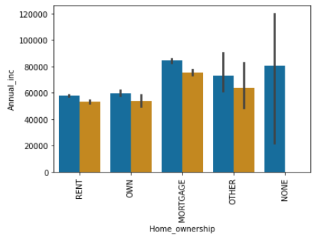
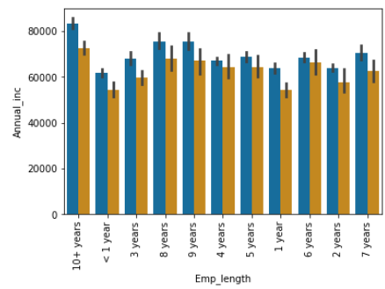

A RISKY BORROWER : Annual Income “59K-82K” Group
No. of Loans taken, issue date & annual income group wise, sorted in descending order
Continued…

Slide 12
Looking at the plots, there are interesting insights about the Loan Defaulters in 59K-82K income group:
1. Most loans taken in Dec 2011 (120) belonged to this income group
2. This group fell in Grade E,F and G, which implies that higher interest rate (Average 14%) was levied up on
3. Most loans were taken for the purpose of Home Improvement, followed by house and then small business
4. People in this group do not own a home or stay in rented place. Instead, they have a home on mortgage i.e. they have an ongoing home loan or belong to Other category
5. DTI is also the highest for this group (Average 14%), which implies about 14% of their monthly income goes into debt payments
6. The defaulters with employment length of 10+ years belong to this income group
It seems that most loans were actually taken for debt payment for the ongoing loans including home loans

Slide 13
RECOMMENDATIONS
The process of verification of income/source of income must be made stringent
The applications from borrowers belonging to annual income group of 59K-82K must be thoroughly analysed
Top five grade/sub-grade in which defaults happen: B5>B3>C1>B4>C2. Applications from borrowers belonging to these grades must be carefully analysed
Safest grade/sub-grade for lending: A4 and A5

Slide 14


